Slide 1
Introduction to Project Management

Slide 2
Objectives
To provide participants with:
An awareness of the importance of applying good practice Project Management in projects of any size.
An understanding of essential elements, including the Leadership Role of the Project Manager, Project Planning, Risk Management and Stakeholder Engagement.
An understanding of the principle elements of design control to be applied within projects at Culham.

Slide 3
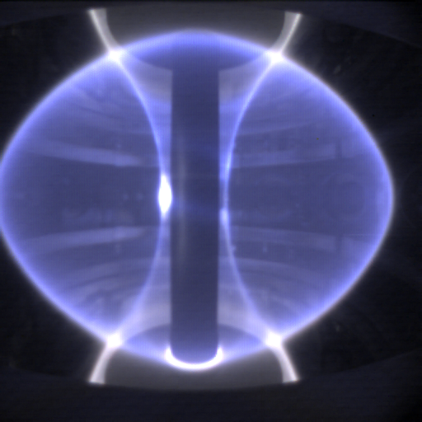
Challenges
“What are the particular technical challenges facing projects?”
Research environment
requirements may be hard to define and may change
producing one or a few items rather than production line
Uncertainties of leading edge R&D ⇒
solutions may have to be developed, including possibly new technologies
‘first of a kind’ so planning and estimating is difficult
Need to balance the desire to get maximum performance versus achieving acceptable reliability/availability

Slide 4
Challenges
“What are the particular management challenges facing projects?”
Requirements hard to define and may evolve
Risk Management (all aspects) crucial but difficult
Cross functional team composition
Competing pressures on resources, e.g. design office
Working with scientific organisations not used to project and QA disciplines ⇒ planning may be poor
Collaborative agreements rather than contracts
Political - EC funding requirements
Growing funding pressures due to ITER

Slide 5
What is a Project?
“Unique process consisting of a set of coordinated and controlled activities with start and finish dates, undertaken to achieve an objective conforming to specific requirements, including constraints of time, cost, quality and resources”
A Project is a planned set of activities
A Project has a scope
A Project has time, cost, quality and resource constraints

Slide 6

What is Project Management?
The art of organizing, leading, reporting and completing a project through people

Slide 7
What is Project Management?
A project is a planned undertaking
A project manager is a person who causes things to happen
Therefore, project management is causing a planned undertaking to happen.

Slide 8
Feedback
What are three attributes of a good Project Manager

Slide 9

Project Manager Role
A Good Project Manager
Takes ownership of the whole project
Is proactive not reactive
Adequately plans the project
Is Authoritative (NOT Authoritarian)
Is Decisive
Is a Good Communicator
Manages by data and facts not uniformed optimism
Leads by example
Has sound Judgement
Is a Motivator
Is Diplomatic
Can Delegate

Slide 10
Stakeholder Engagement

Slide 11
Stakeholder
“A person or group of people who have a vested interest in the success of an organization and the environment in which the organization operates”

Slide 12
Feedback
What are three typical project stakeholders

Slide 13
Feedback - Typical Stakeholders
Sponsor
Funding Body
Customer
Suppliers
End User
HSE/Environmental Agency
Maintenance Team
Neighbours/Community/Shareholders
Fusion Community
Interfaces

Slide 14
Stakeholder Engagement process
Identify Stakeholders
Assess needs
Define actions
Establish communication channels
Gather feedback
Monitor and review

Slide 15
The Project Process
Gate 0
Strategic and Budgetary Approval
Gate 1
Project Justification - Approve Project Definition
Undertake Design
Gate 2
Design Approval - Approval of Final Documents
Gate 3
Readiness for Manufacture - Approval to place Contract
Initiate Project
Prepare Technical Design Ensure Machine Compatibility Prepare Safety Case Modification
Project set-up
Undertake Tender
Major Project Proposals
Project Definition
Conceptual Design
Scheme Design
Detailed Design
Tender Invitation & Assessment
Appoint Project Sponsor Assess Project Priority Assess Budget Implications Est. Proj. Deliverables and Objectives Appoint Project Leader Approve Project Set-up
Raise/Extend/Update initial TCD-R/PERF Prepare Outline Conceptual Design Define Design Constraints Prepare Interface Requirements Spec. (IRP) Finalise Conceptual Design Hold Conceptual Design Review (CDR) Clear CDR Issues Initiate Modification Safety Case Update PMP Approve Proceed to Detailed Design
Extend TCD-Rs/PERFs Prepare Sub-system Detailed Design Hold Detailed Design Review (DDR) Clear Sub-system DDR Issues Use TCD-I/MMAC for Sub-system DD Approval Prepare Final Documents including: - Design Documents., Machine Compatibility Documents., Safety Case Modification
EFDA/CSU/JOC Management
*** These will comprise:
- Technical Specification - Drawings - Contractual Requirements
Project Team/IRP/EFDA/CSU/JDC
Project Team/Interfaces/EFDA/CSU/JDC
* This will include:
- Initial WBS, OBS and CBS - Project Plan - Risk and Procurement Strategies
Draft Statement of Requirements (SoR) Review & Approve SoR Identify Resources Appoint Project Team Produce & Maintain Procurement Plans Undertake Project Risk Assessment Prepare Project Boundary Document Develop Project Management Plan (PMP)* Raise initial TCD-R/PERF** Prepare Preliminary Conceptual Design**
Raise/Extend Sub-system TCD-Rs/PERFs Agree Classifications & Interfaces Prepare Sub-system Scheme Design Hold Sub-system Scheme Design Review (SDR) Clear Sub-system SDR Issues Update PMP Use TCD-I/MMAC for Sub-system SD Approval
Compile Tender Docs.*** Send out Invitations (ITTS) Hold Clarification Meetings Receive Tenders Evaluate Tenders Arrange site visits Approve changes to Specs. Choose preferred Company
** These will only take place here for large projects demanding DO effort for preliminary Conceptual work
Project Team/Contracts/EFDA
Project Leader/Project Team/EFDA/CSU
Project Team/Interfaces
Implement Project
Gate 4
Readiness for Operation - Acceptance of System
Complete Project
Note: Overall Project Management and Reporting will be as defined in the Project Management Plan (PMP)
Manufacture Equipment
Install Equipment
Test & Commission
Confirm Completion
Project Review
Gates (Formal Decision Points) See accompanying notes
Raise Contract Documentation Place Contract Hold Kick off Meeting (KOM) Clarify Issues (Quality Plan) Monitor Progress Witness key Procedures Complete Release Note Approve Complete Package**** Approve Release Note Pack & Dispatch Equipment
Test Equipment against Test Schedule Commission Complete System
Project Team/ICM/EFDA/CSU
Undertake Post Project Review
UNCONTROLLED WHEN PRINTED
Confirm Technical Completion Review Project Records Complete Handover Documents Resolve Reservations Obtain Acceptance of Completed Project
Project Team/CSU
Project Team/Contractor/ICM
Receive Equipment Pre-test Equipment Install equipment
**** This includes supporting documentation
Project Team/ICM
Project Team/EFDA/CSU

Slide 16
Key Points in Project Set-up and Definition
Create Project Management Plan (PMP)
Be clear of scope and objectives
Establish clear statement of what is to be done (WBS)
Establish Risks to be Managed
Establish Costs and Durations
Establish Resources Required

Slide 17
Project management Plan - PMP
Master Document for Project
Defines the following:-
Project Objectives, Scope, Deliverables
Stakeholders (Internal & External)
Work to be done (WBS)
Project Organisation and Resources (OBS)
Project Costings (CBS)
Project Schedule
Procurement/Contract Strategy
Risk Management
Quality management
Change Management

Slide 18
Project Planning

Slide 19

Project Planning
Adequate planning leads to the correct completion of work

Slide 20
Planning
Inadequate planning leads to frustration towards the end of the project & poor project performance
Project Start
Project End

Slide 21
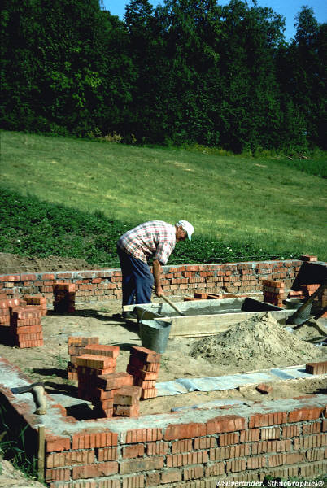
Work Breakdown Structure (WBS)
The Work Breakdown Structure is the foundation for effective project planning, costing and management.
It is the most important aspect in setting-up a Project
It is the foundation on which everything else builds

Slide 22
Work Breakdown Structure - Definition
“A Work Breakdown Structure (WBS) is a hierarchical (from general to specific) tree structure of deliverables and tasks that need to be performed to complete a project.”

Slide 23
Example WBS - Top Level ILW Project

Slide 24
Example WBS - Top Level TSCL Project

Slide 25
Project Planning – WBS (1)
Lowest Level of WBS is the Work Package (WP)
WP can be clearly defined allowing package to be costed, scheduled and resourced
WP contains a list of Tasks to be Performed that form the basis for the Schedule
WP allows assignment of responsibilities (Work Package Manger, WPM)

Slide 26
Project Planning – WBS (2)
WBS allows hierarchical build-up of costs and schedule
Cost and Schedule can be reported at any level of the WBS
WBS facilitates strong management during project execution (Cost and Schedule control)
WBS can be used for many other things - Document Management, Risk Management etc.

Slide 27
Project Planning
A word about Scheduling
Schedules (task durations) can have a wide variation
There is no unique answer. Rather, there is a statistical variation depending on assumptions
Need to understand the basis of scheduling (Most challenging; Most likely; Absolute certainty - bet your life on it!)
Most people are very optimistic/naive

Slide 28
Project Planning – Key Points
Recognise that adequate project planning is essential
Produce a sound WBS
Use the framework provided by the Project Management Plan (PMP) template
Involve the right people
Allow enough time
Be systematic

Slide 29
Project Risk Management

Slide 30
Project Risk – Definition (1)
“Project risk is an uncertain event or condition that, if it occurs, has a positive or negative effect on a project objective”

Slide 31
Project Risk – Definition (2)
“A combination of the probability of a defined threat or opportunity (Likelihood) and the magnitude of the consequences of the occurrence (Impact) defines a Risk Index”

Slide 32
Risk Impact
Threat → Scope → Poor Quality Product
Threat → Schedule → Late Delivery
Threat → Cost → Overspend
In addition there are health, safety and environmental threats that must be managed (CDM Regulations)

Slide 33
Risk Management Process
Identify Risks
Assess likelihood and impact
Rank risks and prioritise
Define risk management approach & actions
Implement actions
Monitor & review

Slide 34
Risk Management – Key Points
Make the management of risk integral to the way the project is managed
Ensure that cost and time contingencies are consistent with identified risks
Focus on the “significant few” – don’t try to manage too many risks
Be vigilant and proactive

Slide 35
Project Monitoring and Control

Slide 36
Feedback
What are three typical project control/monitoring activities

Slide 37
Project Monitoring
Typical Monitoring Activities
regular reviews of progress against schedule using WBS as basis (Plan against Baseline)
regular review of actual costs (O/P from SAP) against budgeted costs and Earned Value at WBS level
regular review of resource loading
regular progress meetings with project team
regular meetings with contractors
production of periodic progress reports
risk reviews
inspections/ audits

Slide 38
Project Control
Typical Control Activities
assign responsibilities at Work Package level
staged authorisation of work to be done
staged release of budgets (staged release of WBS(e) numbers)
ensure PM has a ‘Management Reserve’ under his control
seek corrective action reports when WPs go ‘off track’ (overrunning or overspending)
release Management Reserve carefully

Slide 39
Project Monitoring and Control Summary
Monitor against the plan – status regularly
Take a factual approach to decisions
Identify management action early
Check that defined controls are being applied – correct if necessary
Apply change control

Slide 40
Design Management
Design takes place as part of a project
Design Management is part of Project Management
Design Management considerations must be included in the PMP

Slide 41
Feedback
What are three Design Management Activities

Slide 42
Feedback - Design Management Activities
Sub-divide Design Stages (CD, SD & DD)
Sub-divide Tasks (WBS)
Define Constraints and Interfaces (WPD Summary Sheet)
Formally Initiate the Design (TCD-R/PERF)
Ensure Design conforms to H&SE and CDM Requirements
Hold Design Reviews (Peer review)
Formally Approve Design (TCD-I/MMAC)

Slide 43
Design Stages
Conceptual Design
Scheme Design
Detailed Design

Slide 44
Conceptual Design Phase
TCD-R
Decide Local or TCS route
Develop Conceptual Design
Define Constraints & Interfaces
Carry out Conceptual Design Review
Initiate Safety Case Modification if required
Obtain Approval to Proceed to next stage

Slide 45
Scheme and Detailed Design
Basic considerations and process similar to concept
Need to ensure that safety & environmental issues receive proper consideration as design develops (CDM Regulations)

Slide 46
Feedback
Who should be invited to a design review
Write down three issues that should be considered at a design review

Slide 47
Feedback - Design Reviews, Attendance
Project Leader or nominee (Chairman)
RO (Work Package Manager)
Customer
End User
Safety and Quality Reps
All other Relevant Interfaces/Stakeholders
Other Experts in the area being reviewed

Slide 48
Feedback - Design Reviews, Issues to Consider
Assumptions and Constraints
Technical Solutions - Does it meet the Spec?
Safety, Environment and CDM issues
Can it be Manufactured/Maintained?
Actions from previous DRs
Issues to be resolved (including Timescales)

Slide 49
Safety & Environment
Need to ensure that safety & environmental issues receive proper consideration as design develops
Involve the right people from the start
Systematically identify issues – Hazards/Risks, Environmental Aspects & Impacts
Carry out rigorous reviews at each design stage
Control Design Changes
MUST take note of CDM Regulations

Slide 50
CDM Regulations
CDM - Construction (Design & Management)
Regulations recently updated
Now must have someone in EACH Project Responsible for CDM
Currently information is on the Conceptual, Scheme & Detailed Design steps on the Process Maps
More information will be developed over the coming months

Slide 51
Design Change control
Needs to be a formal and defined procedure
New procedure in place CD/P/J008 for JET Facilities

Slide 52
Confirm Completion
Ensure design records are complete and accurate
Ensure any outstanding actions or issues are addressed
Ensure Maintenance Records are produced
Ensure User Manuals are produced
Hold a formal Post Project review

